Slide 1



Development of a simulative environment for a teleoperation task using an Haptic Device
Faculty of Information Engineering, Computer Science and Statistics
M.Sc. in Artificial Intelligence and Robotics
AA 2015-2016
Professor:
Marilena Vendittelli
Alessandro De Luca
Presenter:
Aloise Irvin, Colosi Mirco, Gigli Andrea

Slide 2
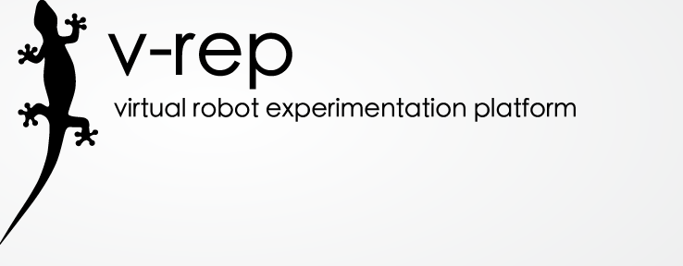
V-REP (http://www.coppeliarobotics.com/)
Free, open-source, multi-platform robotics simulator
Provides engines for dynamic/physics simulations
Many robot models are available in the standard distribution
It’s functionalities can be extended using many programming languages (C/C++, Matlab) and programming approaches (remote clients, plugins, ROS nodes)
In our approach, we developed a C++ plugin in order to perform needle penetration simulation.
Learning Transferable Features with Deep Adaption Network
08/11/2016

Slide 3
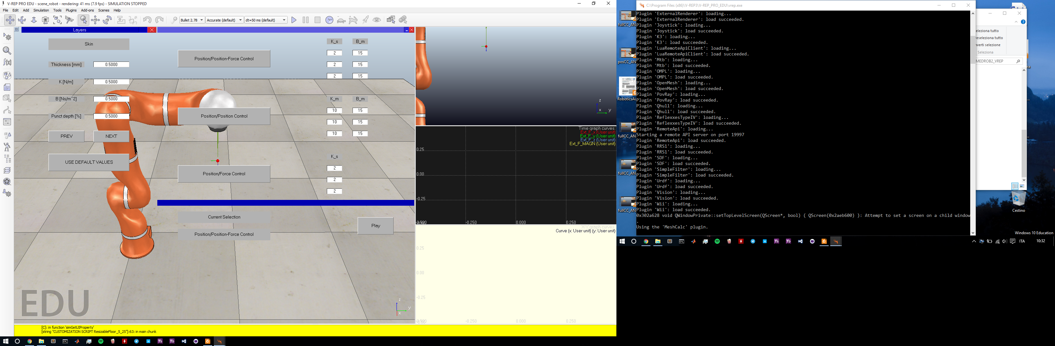
Interfaces (layers)
The user is able to chose the parameters of the 4 layers
Using the PREV/NEXT buttons the tab will switch between the layers
If the user doesn't want to fill all the layers’ parameters, he can use the default values we set on the code
Once the choice is done, the user can close the window and switch to the following interface
Learning Transferable Features with Deep Adaption Network
08/11/2016

Slide 4
Interfaces (controller)
Through this interface the user can select and set the parameters of a controller
The current selection will be shown on the bottom section of the GUI
Thanks to the “Play” button the simulation will start with the desired parameters
Learning Transferable Features with Deep Adaption Network
08/11/2016

Slide 5
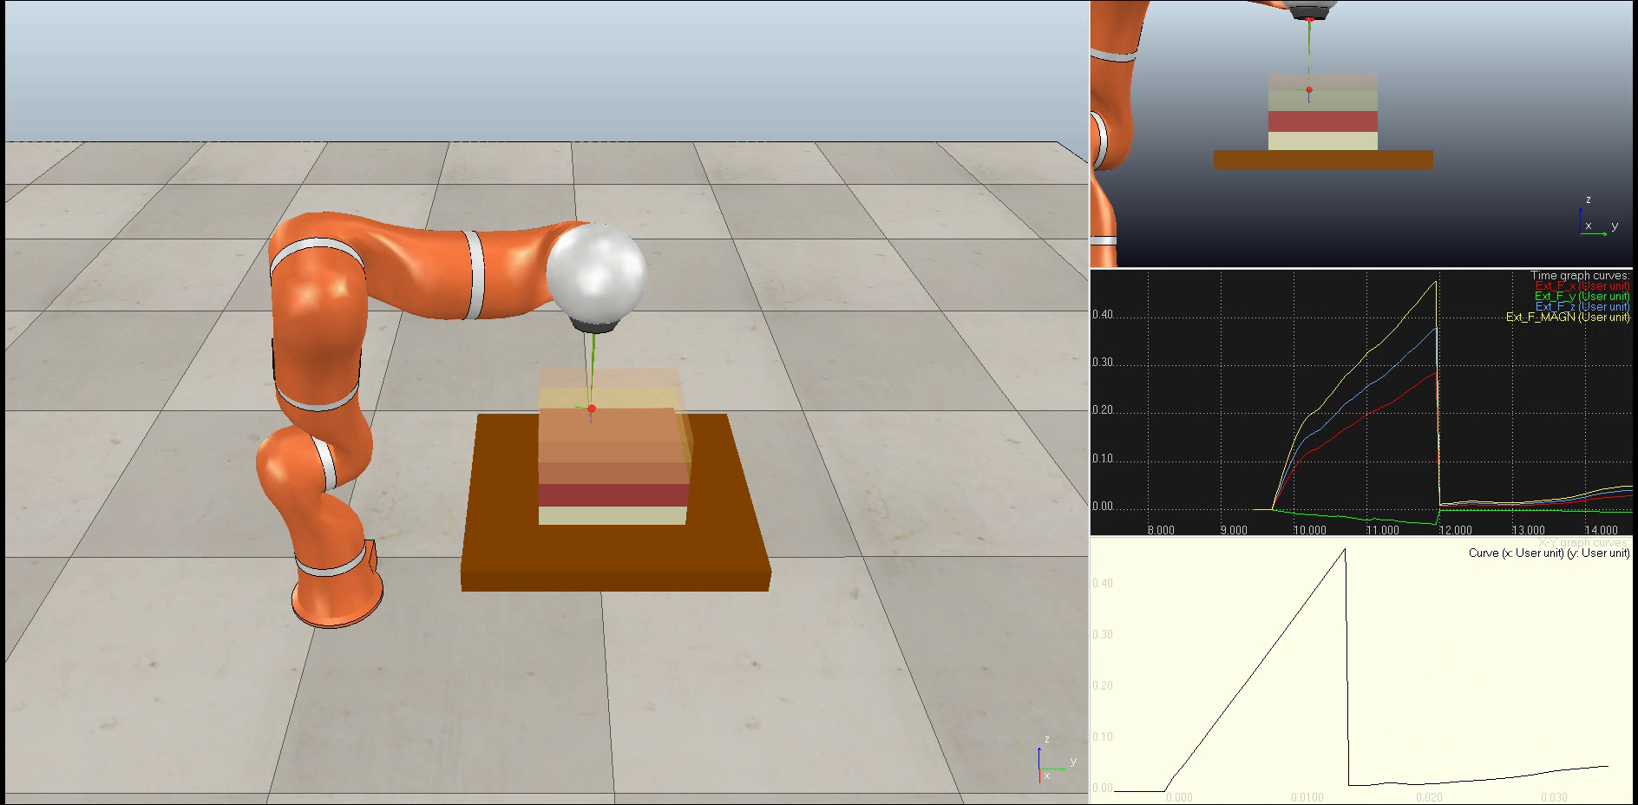
Views
Arbitrary view
Side view
External forces graph
Depth/forces graph
Learning Transferable Features with Deep Adaption Network
08/11/2016

Slide 6
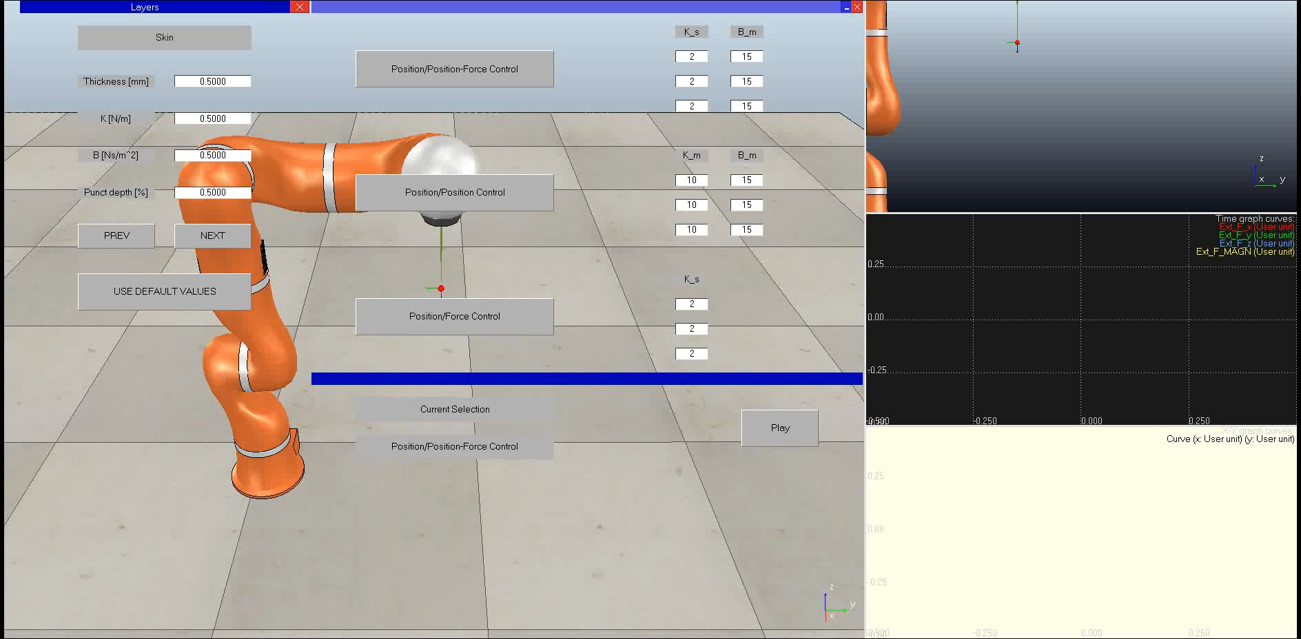
Virtual Coupling
The device’s workspace is too small with respect with the scene
With lower resolution the device’s workspace will increase in dimension, but precision in simulation will be worse
The solution is to implement clutching through virtual coupling
Learning Transferable Features with Deep Adaption Network
08/11/2016

Slide 7

Penetration
Learning Transferable Features with Deep Adaption Network
08/11/2016

Slide 8
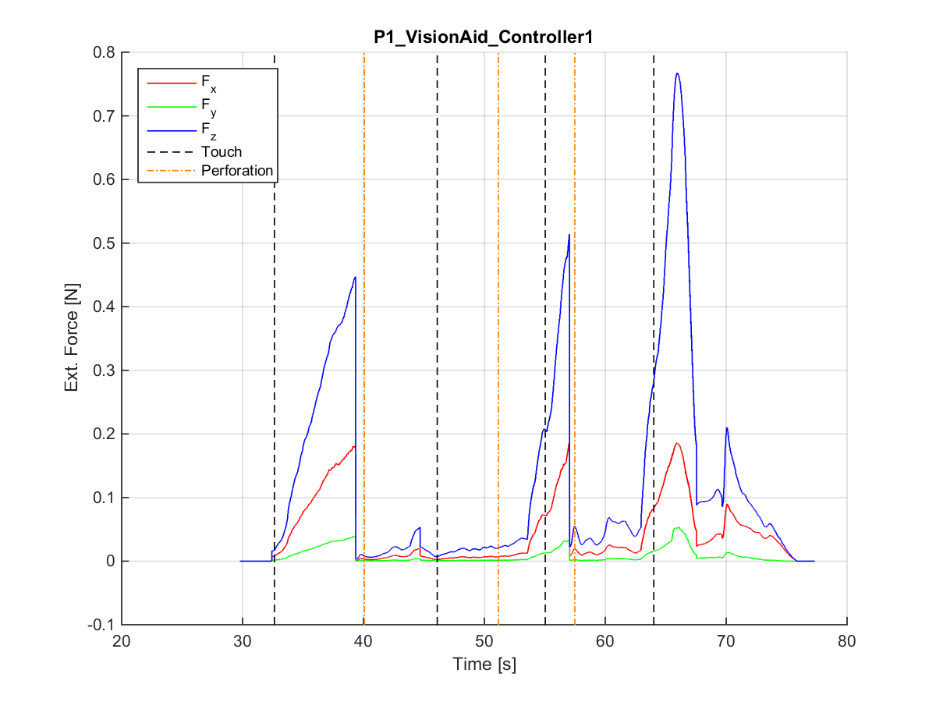
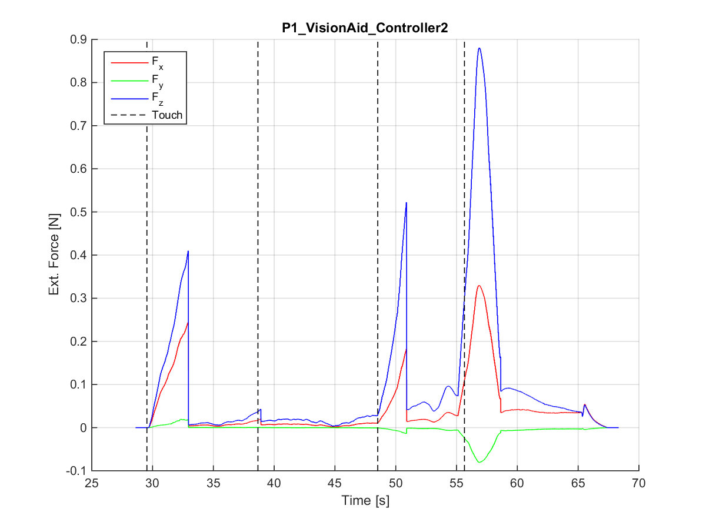
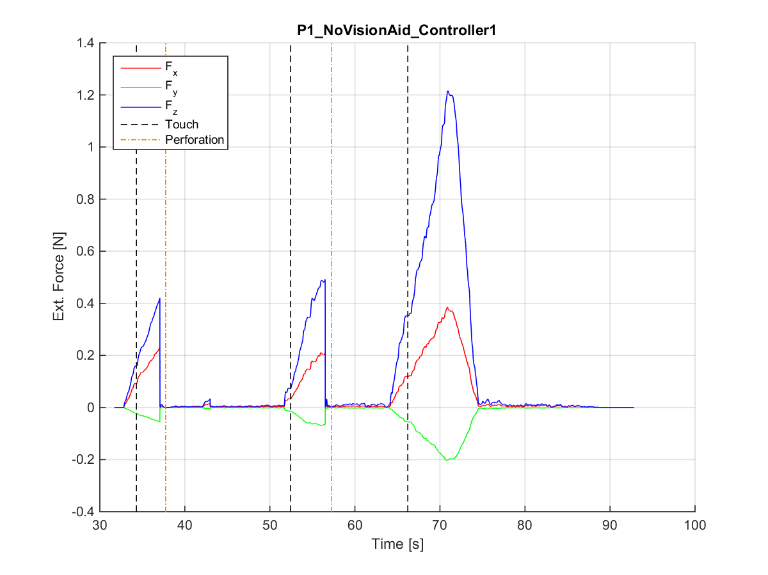
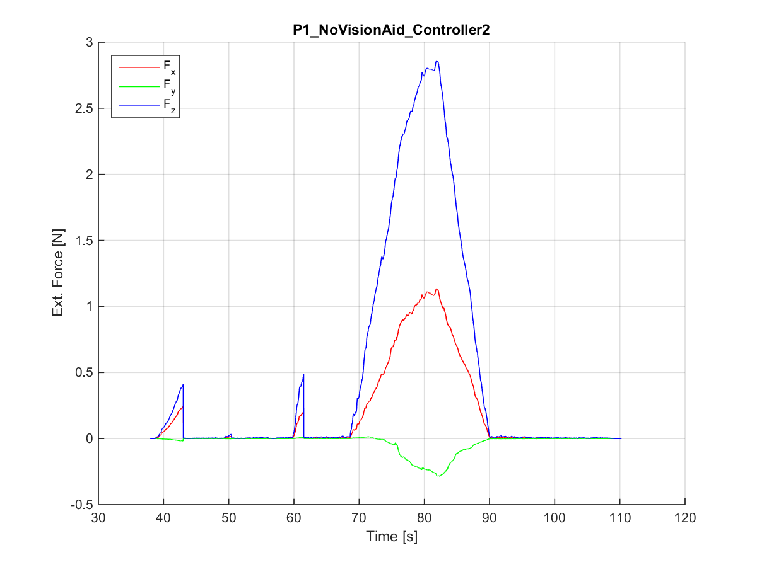
Simulations
TASK: complete penetration of the tissue and recognition the layers
Comparison between vision aided and haptic feedback only simulations with different teleoperation schemes
Learning Transferable Features with Deep Adaption Network
08/11/2016

Slide 9
Discussion and Future Works
The aim of this project is to build a simulative framework in VREP in order to teleoperate a KUKA LWR 4+ robot using a Geomagic Touch as master robot implementing different teleoperation schemes
The experiments underlined how some of the proposed teleoperation schemes are not suitable for such tasks
VREP is not able to properly manage interactions between objects → different platform, e.g. Unity
The device has a passive gimbal so cannot provide forces on its last 3 joints → a more professional haptic device allows users to perceive more realistic sensation
This work can be transposed in real-word applications using a robot manipulator to accomplish this task
Learning Transferable Features with Deep Adaption Network
08/11/2016

